Slide 1
Technical Approach
Our goal was to use rule association to find sales opportunities for the bakery.
We did this by calculating several different types of statistics and algorithms to find various insights.

Slide 2

Support
The support of an item, or a set of items is the frequency that it appears in the dataset.
We use support to find the most popular items and item combinations, to find out the best deals to offer and items to increase or decrease our production of.
We calculate this using this code:

Slide 3

Confidence
The confidence of a set of items is the prevalence of the second item in entries that already have the first.
We use confidence to find the best pairing deals to suggest to a customer (i.e. they may be interested in a bread item if they are buying coffee)
We calculate this using the following code:

Slide 4

Lift
The lift of a set of items is the confidence divided by the support for the second item alone
Lift is the key to determining what is a well-targeted sale, while all items will be heavily associated with coffee in a bakery, that isn’t necessarily a well-targeted sale.
We calculate lift using the following code:

Slide 5
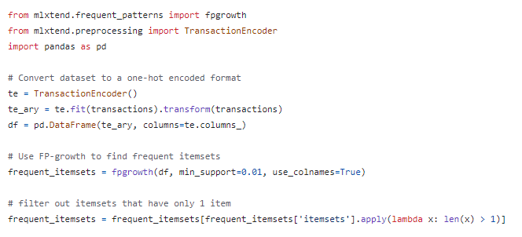
Rule Associations Using FP-Growth
The fp-growth algorithm is an algorithm that identifies frequent association rules by creating a frequent pattern tree.
We implement this algorithm using the mlxtemd python library like this, which finds rules with a minimum support:

Slide 6
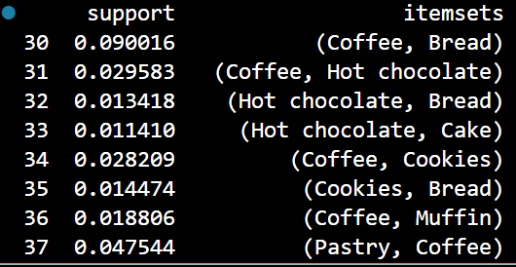
Issues With This Approach
You can see that at the end we have to filter out groups with only 1 item, this is because those will show up most prevalently always but aren’t very useful data.
After doing this we get much better results:

Slide 7
Summary of Solution Approach
We use a combination of Support, lift, confidence, and association rule mining to arrive at a list of best fit items for sales together.
Some insights will come from naively using support and confidence: coffee and bread are very popular and should be targeted for sales.
Other more targeted insights will come from lift and rule association mining: Hot chocolate and cake are very commonly bought together, despite being less popular items.

